Slide 1
Python – Break and Continue
Premanand S

Slide 2
Break and continue
To alter the flow of a loop
Loops iterate over a block of code until the test expression is false, but sometimes we wish to terminate the current iteration or even the whole loop without checking test expression
Break and continue

Slide 3
Break
terminates the loop containing it
Control of the program flows to the statement immediately after the body of the loop
If the break statement is inside a nested loop (loop inside another loop), the break statement will terminate the innermost loop
break

Slide 4
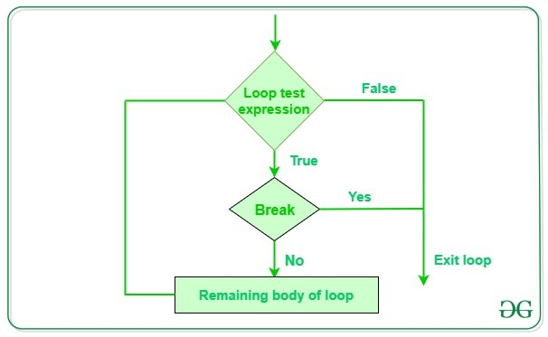
Break – work flow

Slide 5
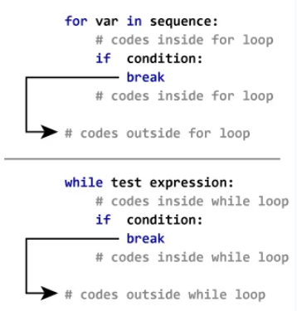
Break – for and while loops

Slide 6
Continue statement
The continue statement is used to skip the rest of the code inside a loop for the current iteration only.
Loop does not terminate but continues on with the next iteration
continue

Slide 7
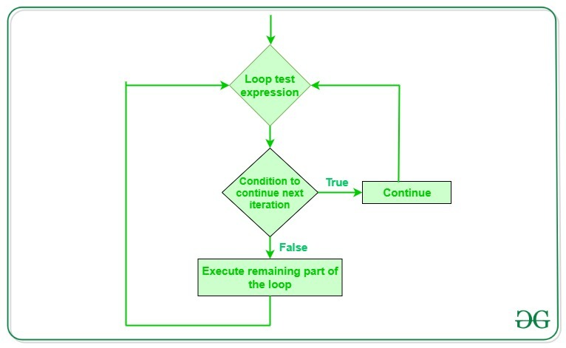
Continue – work flow

Slide 8
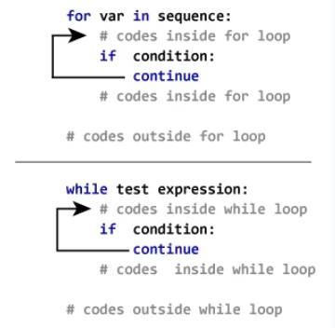
Continue statement for for and while loop

